Slide 1
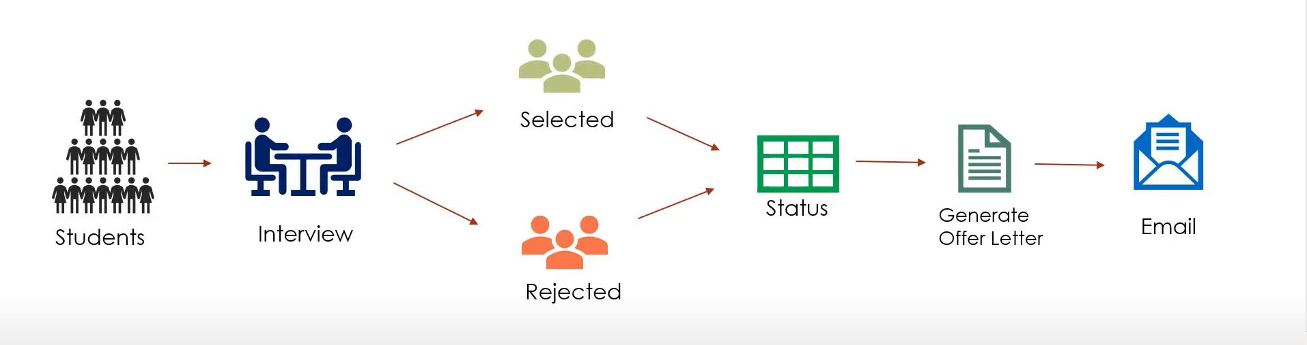
AS IS Process (Manual)

Slide 2
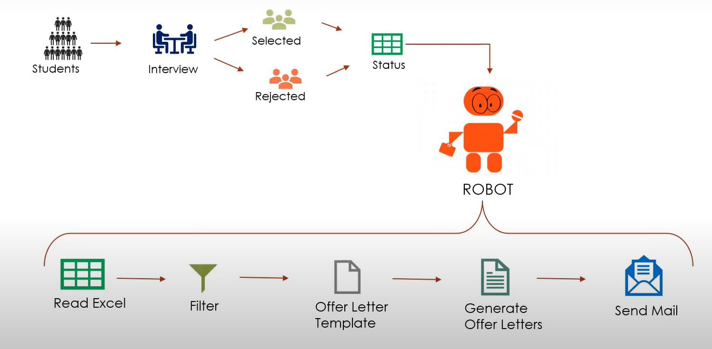
TO BE Process (Automated)

Slide 3
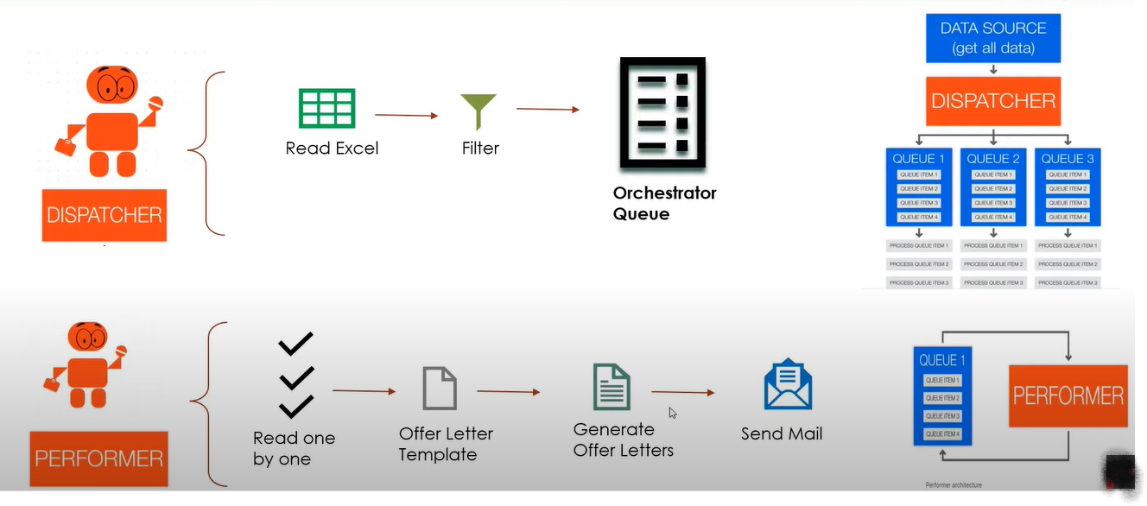
TO BE Process (Automated)

